Slide 1
West Yorkshire Health and Care Partnership
Primary care ‘Leaving a Gap’ campaign
Launch date: Monday 21 March 2022

Slide 2
Primary care:
Leaving A Gap Campaign
COMMUNICATION TOOLKIT

Slide 3
Introduction
Due to an unprecedented level of need for appointments in primary healthcare, there has been a lack of public understanding around the roles and responsibilities of healthcare colleagues, with GP practices and pharmacists seeing an increase in reports of abuse towards staff.
Some helpful work has been done within the wider partnership such as ‘Together we can’ and ‘Why is my GP working differently?’ to tackle some of the issues arising. However, it is felt that a campaign directly tackling the issues around abuse towards primary care colleagues was needed to help change perceptions and ultimately positively influence some patients' behaviour.

Slide 4
The ask
Start to rebuild trust and restore the strong relationship between the public and primary care services – but specifically motivate the public to be understanding and kind to staff under this period of resource pressure and change.

Slide 5
Objectives
REDUCED LEVELS OF ABUSE TOWARDS STAFF
REDUCED DISTRESS / STRESS AMONGST STAFF
INCREASED STAFF RETENTION
UNDERSTANDING OF THE IMPORTANCE OF KINDNESS (ALL ROUND).

Slide 6
MEDIA RELEASE / WEB COPY FOR LOCAL ADAPTION IF HELPFUL
Don’t ‘leave a gap’ in our workforce, Partnership urges
During the pandemic, reports of abuse directed at doctors’ surgery staff and community pharmacy teams across West Yorkshire have increased. In response the West Yorkshire Health and Care Partnership (WY HCP) has launched a new insight driven campaign called ‘leaving a gap’ to make people think about the consequences of abusive behaviour. Co-produced with staff and patients, the campaign recognises that services are extremely busy, and it can be frustrating for people accessing care.
The campaign reminds people we’re all here to help each other and the importance of all round understanding and kindness.
A series of striking images created as part of the campaign aim to make people think about the gap that will be left if staff leave their role due to abuse.
This comes following an unprecedented level of need for advice and appointments in primary care. There has been a 15% increase in demand since the same time two years
ago with community pharmacies managing increasing numbers of people, many GP practices receiving more than 1000 telephone calls every day, alongside delivering
lifesaving flu and COVID-19 vaccines.
Abuse directed at GP practices and community pharmacy teams means receptionist and counter staff deal with the most insults and threats. As a vital part of the health
care team, they are skilled in helping care for people and treating all information confidentially. They ask questions to direct people to the best support and are trying to help.
Teams have been spat and sworn at, their cars damaged, received death threats and been in tears, regularly.
Dr Richard Vautrey, Leeds GP said “Services remain exceptionally busy, and whilst GP teams are working as hard as they can we know it can be very frustrating for patients.
This campaign is all about asking people to take a moment to think before speaking with our staff. Abuse is significantly impacting staff morale at a time when the workforce
has never been so stretched. It is in danger of driving away staff from a profession under pressure –
staff leaving their jobs won’t help anyone and will only make the situation worse”.
Dr James Thomas, Chair of WY HCP Clinical Forum said “GPs are working differently, whilst helping more people than ever before. One conversation can be enough to
hurt. It’s important that we all take time to consider our behaviours and how it can impact on others. Being kind can make a huge difference to someone’s day”.
Ruth Buchan Chief Executive Officer at Community Pharmacy West Yorkshire said “While most people treat our staff with the respect they deserve in the workplace,
sadly, community pharmacy teams are facing increased abuse. We are here to help you with advice and medicines. Please don’t take your frustration out on our teams.
I know things can be frustrating but let’s be kind to each other, it can make a huge difference to someone’s day and work life”.
You can find out more at: www.wypartnership.co.uk/leaving-a-gap

Slide 7
Campaign creative
In our approach we have created communications that highlights the real consequences of abusive behaviour.
We have used real life settings to draw the attention of the viewer to the fact that if they abuse a member of the primary care team
they might leave the NHS. This creates gaps in the service, meaning that it becomes harder for it to run smoothly and efficiently. -
Making it harder for everyone.
The text in the campaign materials takes a factual and balanced tone. While we are pointed in telling our audience that abusive behaviour
creates a negative outcome for everyone, we are also consolatory in recognising that due the high demand, things aren’t perfect.
In this way we hope people will feel sympathetic and be more understanding towards staff.
The photography does not feature the person being abusive, as the viewer could equally become angered or disassociated with the person shown.
Neither does the campaign materials show the primary care worker, as it can be seen as being representative of everyone in
the organisation.
Messaging
ABUSIVE BEHAVIOUR CAN LEAVE GAPS.
Currently our services are extremely busy; we know it's frustrating.
Unfortunately, verbal and physical abuse towards our colleagues can contribute to us losing staff, leaving gaps and making it harder to run our services.
We’re all here to help each other – please be kind

Slide 8
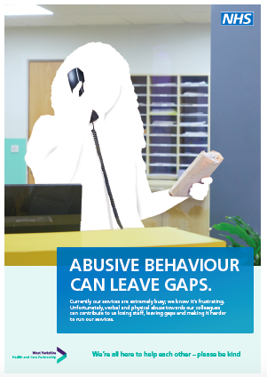
Creative overview

Slide 9
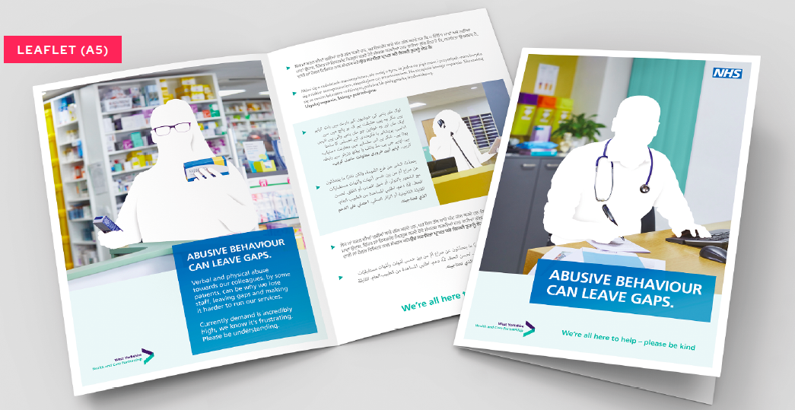

Slide 10
Campaign start date
The campaign will launch on Monday 21 March with a small spend on paid social media so we can monitor and review people’s responses.
Social media will be posted by each clinical commissioning group Facebook/other socials and also by organisations direct.
We are then going to pause and assess feedback and distribute the remaining spend for social in the target areas which the highest impressions.
In addition, there are a number of assets such as posters and a leaflet which can be sent for printing
to use within the primary care setting. A full list of assets can be found on the following web page and there is translated information.
*Please note social media comments will need to be monitored by the CCG’s.
Asset downloads:
https://www.wypartnership.co.uk/our-priorities/primary-and-community-care-services/leavinging-a-gap

Slide 11
Print Assets:
A3 Poster
A4 Poster
A5 Leaflet
Digital Assets for practices, pharmacies and clinical commission groups to use:
Website Banner Folder
Website Hero Image Folder
Animations Folder
Email Signature Folder
Facebook Cover Photo Folder
Facebook Post Folder
LinkedIn Page Cover Image Folder
LinkedIn Post Blog Image Folder
LinkedIn Profile Cover image Folder
Twitter Profile Cover image Folder
Teams Background Folder
Digital Poster Folder
Translations:
Arabic
Kurdish
Pashto
Polish
Punjabi
Urdu
Campaign materials
Campaign material can all be viewed and downloaded on the
partnership website
https://www.wypartnership.co.uk/our-priorities/primary-and-community-care-services/leaving-a-gap
Printed posters and leaflets will be arranged by your clinical communications teams. Please contact them for further information.

Slide 12
Social media
Social media timeline:
We will launch the campaign on the 21 of March with 10% of the budget across West Yorkshire to gauge the reaction of the public - 2 weeks will be enough time to collate this data. From the 4 of April, we will then allocate the remaining 90% of the budget across the relevant areas depending on the population disparity – This will run for the remaining 6 weeks of the campaign scheduled to end on the 23rd of May.
Body copy Instructions:
There are three set of creatives which can be used across all social platforms including Facebook, Instagram, Twitter Social Post that are static. Please ensure the body copy below is what is used in the post. The same copy can also be used across any animated posts.
ABUSIVE BEHAVIOUR CAN LEAVE GAPS.
Currently our services are extremely busy; we know it's frustrating. Unfortunately, verbal and physical abuse towards our colleagues can contribute to us losing staff, leaving gaps and making it harder to run our services.
We’re all here to help each other – please be kind

Slide 13
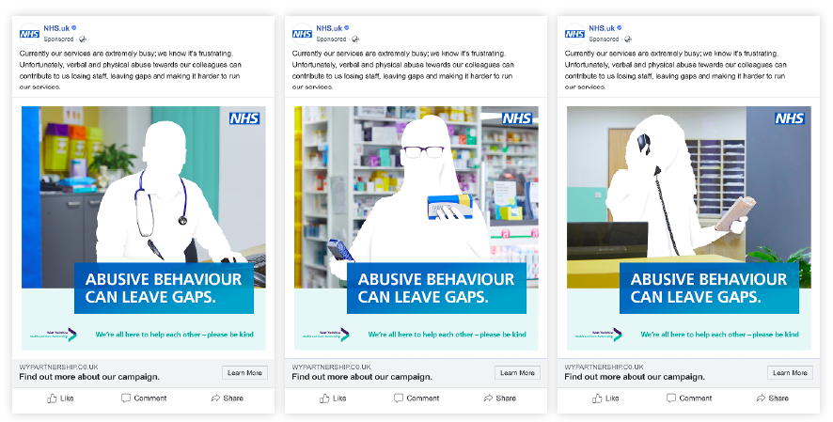
Social media route overview
Example of advised posting format

Slide 14
1. Why are you doing this campaign?
To highlights the real consequences of using abusive behavior towards primary care staff
To highlight the pressure on people wanting to access care and also on colleagues.
2. What’s led the reasoning behind the campaign in the first place?
Abuse directed at GP’s, receptionists and pharmacy community teams has increased over the pandemic while services remain exceptionally busy. Staff have been threatened, spat at and even had their personal possessions damaged.
We have tested the messages and campaign images with patients and primary care staff.
3. What’s the messaging?
We want to let people know that abusive behavior creates a negative outcome for everyone, we are also consolatory in recognising that due the high need, things aren’t perfect.
4. What are you hoping is the outcome?
By highlighting the consequences of this abuse, the hope is people will feel sympathetic and be more understanding towards primary care staff.
5. How long is the campaign running for?
The campaign is running for two months, starting from the 21 March and ending in May 2022.
10
Key messaging
for staff to use
1-5

Slide 15
10
Key messaging
for staff to use
6-10
6. Where else is the campaign being shown?
We have printed media within the primary care setting while also engaging with a social media campaign.
7. Are you accusing all patients of being abusive?
Certainly not. We are highlighting that some patients behave in a manner which causes distress and upset to primary care staff which can be a contributing factor to people leaving. We understand frustrations, and we all need to be kind to one another.
8. Why is this campaign only focused on primary care staff and not the wider NHS?
The campaign was requested by and funded from primary care. There will be an opportunity in the future to expand into further areas to target specific needs, if helpful and following evaluation.
9. Some staff can be rude to patients
This is about recognizing frustrations and reminding people to be kind to one another.
10. Will you be evaluating the campaign
Yes, we will evaluate the campaign to see if it has made a difference.

Slide 16
Sources
There is an unprecedented level of demand for appointments in primary care with a 15% increase in demand since the same time two years ago and many GP practices receive more than 1000 telephone calls every day. Survation qualitative research (Sept 2021).
Community pharmacies are increasingly becoming the first port of call for people needing healthcare advice. In January 2021, an audit was carried out to quantify the pressures pharmacies are under as a direct result of providing informal patient consultations, often on a walk-in basis. This found that nationally, pharmacies were undertaking some 58 million informal consultations per year, without additional resources.
In England, in an average week, over 600,000 community pharmacy consultations are carried out to respond to patients' symptoms. Were pharmacies not there, it would result in approximately 492,000 additional GP appointments each week, or 65 appointments in each GP practice each week in England.

Slide 17
Thank you

