Slide 1
Resources to share with patients on problematic polypharmacy and deprescribing Reducing polypharmacy and the deprescribing of inappropriate or unwanted medicines is better for patients and the planet Resources compiled by Heather Smith, Consultant Pharmacist for Older People, the Leeds Medicines Optimisation Team, West Yorkshire Integrated Care Board

Slide 2
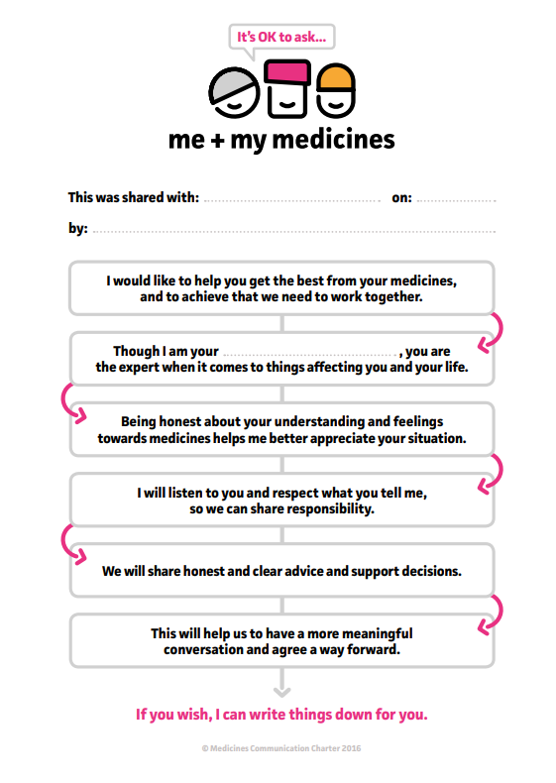
Shared Decision-Making Resources
Me and My Medicines​: Me & My Medicines; It's OK to Ask - a patient designed communication charter help people raise concerns and use their medicines better
​
The Health Innovation Network: Resources to support patients having a Structured Medication Review; resources to help patients get involved when a healthcare professional is reviewing their medicines​.
This is available in 8 languages and as an animation​: patient-information-resources in 8 different languages ​
Questions to ask to help you make a shared decision with your healthcare professional​ -
Ask 3 questions
Dehttps://aqua.nhs.uk/resources/shared-decision-making-ask-3-questions/cision Making – Askuestions– Aqua​
​The Choosing Wisely website aims to improve conversations between patients and their healthcare professionals ​and includes a patient information leaflet about how to make the most of your appointments: patient information leaflet to help you make the most of your appointment

Slide 3
Patient / public resources on polypharmacy
Why more medicines isn't always better for older people – an Age UK report about medication and overprescribing: More harm than good; why more medicine isn't always better for older people ​
A resource from the Canadian Medication Appropriateness and Deprescribing Network - Information for patients and the public on the potential harms of too many medicines or certain types of medicines and what people can do if they are worried: What is deprescribing?
The Canadian Medication Appropriateness and Deprescribing Network resources are also translated into other languages here: Resources translated into other languages
Resources from Canada and Australia about the potential harms of anticholinergic medicines:
An explanation on what anticholinergic medicines are and their potential harms
Falls, confusion... is it my medicine?
Questions you might have about anticholinergic medicines
Information for patients and the public on how to live well with pain: https://livewellwithpain.co.uk/

Slide 4
Resources for those with chronic pain
Are you or someone you know, living with chronic pain? The resources below are all about how people can live better whilst experiencing chronic pain.
Live Well with pain - Information for patients and health care professionals, including the ‘Ten Footsteps to Living Well with Pain’ - a step-by-step online guide to living well despite persistent pain and information on opioid reduction
Pain concern - charity for people with pain including a podcast
Flippin’ Pain™ - a public health campaign with a clear goal: To change the way we think about, talk about and treat persistent pain.
Retrain Pain - website with a science based approach to help people overcome chronic pain. Information available in a variety of languages
Pain Toolkit - pain self-management advice
Opioids Aware – a resource for patients and healthcare professionals to support prescribing of opioid medicines for pain
Reducing harm from opioids for chronic non-cancer pain – padlet page collated by the Yorkshire & Humber Patient Safety Collaborative - Medicines Safety programme (MedSIP)

Slide 5
Resources for those with chronic pain
Videos:
Tame the Beast - Useful 5 minute video to help understand pain
Understanding Pain in less than five minutes - Brainman
Understanding Pain – Brainman Chooses
Understanding Pain – Brainman stops his opioids
The Brainman videos are available in a variety of languages/subtitling:
https://www.youtube.com/@HunterBrainman/videos
Podcast:
Podcast: Quitting Prescription Opioids - Patient testimony

