Slide 1
System Transformation Fund (STF) Lipid Optimisation Project
Results and Learnings, June 2024
WYICB Project Team: Pei-Theng Aizlewood, Julia Faulkner, Mohammad Fazlee, Samiullah Choudhry and Rizwana Anwar
LTHT Lipid Medicine Optimisation Team: Rani Khatib, Abi Barrowcliff, Harpal Ryatt, Alia Awni, Eunice Ikongo

Slide 2
STF Project Aims
1) Set up WY Lipid Optimisation Clinical Taskforce (LOCT)
2) Engage most deprived PCNs to drive lipid optimisation priorities in primary care
3) Set up a virtual lipid MDT to support primary care workforce with specialist access and increase confidence in lipid optimisation
4) Improving referrals to community pharmacies New Medicines Service

Slide 3
Challenge Statement:
Health inequalities existed where the most deprived areas had higher prevalence of poor lipid optimisation.
Assumption:
There is knowledge gap and lack of clinical leadership in primary care to improve lipid optimisation.
What was the main goal? To upskill primary care clinicians (from most deprived PCN areas) to do lipid optimisation.
What did we want to achieve? To improve lipid management of patients with CVD living in most deprived areas.
How did we achieve it? Integrated MDT approach, A&G support, virtual lipid MDT discussion, virtual training webinars

Slide 4
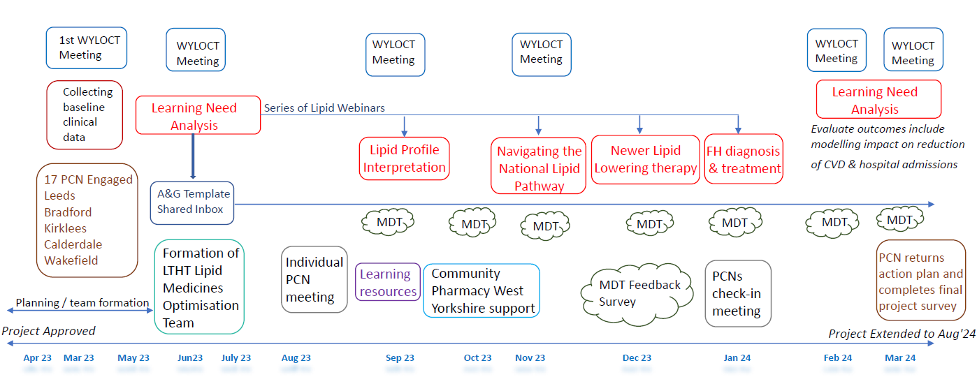
STF Project Delivery Timeline

Slide 5
Activities Reports
16 PCNs signed up plus 4 new PCNs onboarded during extension
Delivered 4 webinars (open to everyone across West Yorkshire)
Received 72 A&G (8 rejected)
8 virtual lipid MDT – 31 cases discussed
Set up WY LOCT – had 6 bi-monthly meetings between April 2023 to April 2024, continues under WYICB LTC and Personalised Care Team.

Slide 6
List of Participating PCNs
PCNs | Place in WYICS | Number of Referrals
BRADFORD CITY 4 PCN | Bradford | 0
BD4+ PCN | Bradford | 0
THE FIVE PARKS PCN (was previously known as PCN7) | Bradford | 2
BRADFORD NORTH WEST PCN | Bradford | 0
FIVE LANE ENDS PCN | Bradford | 1
BURMANTOFTS, HAREHILLS & RICHMOND HILL PCN (BHR) | Leeds | 13
BEESTON PCN | Leeds | 7
SEACROFT PCN | Leeds | 12
MIDDLETON AND HUNSLET PCN | Leeds | 0
BRAMLEY, WORTLEY & MIDDLETON PCN (BWM) | Leeds | 3
NORTH HALIFAX PCN | Calderdale | 0
DEWSBURY & THORNHILL PCN | Kirklees | 15
WAKEFIELD NORTH PCN | Wakefield | 1
CENTRAL HALIFAX PCN | Calderdale | 0
WAKEFIELD HEALTH ALLIANCE SOUTH PCN | Wakefield | 4
VIADUCT CARE PCN | Kirklees | 4
CHAPELTOWN PCN (Extension) | Leeds | -
LOWER VALLEY PCN (Extension) | Calderdale | -
NORTH BRARDFORD PCN (Extension) | Bradford | 2
PONTEFRACT AND KNOTTINGLEY PCN (Extension) | Kirklees | -

Slide 7
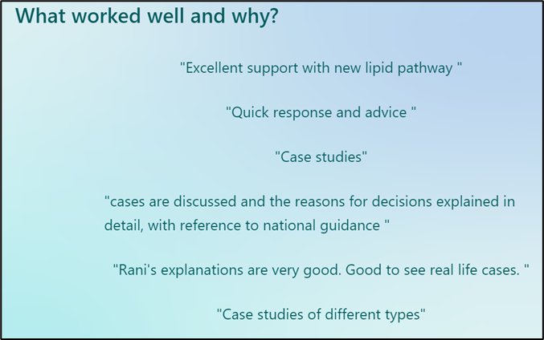
MDT feedback questionnaire
Received 18 responses.
Excellent MDT service feedback, with an average rating of 4.78 out of 5, with 5 being “most valuable”.
Notes:
MDT sessions and feedback - very positive

Slide 8
Webinars Feedback
Webinar | Number attended | Number of recording being sent to registrants | Number of feedback responses | Has the webinar covered their learning needs? | Level of knowledge before and after (score of 1 to 5, 1 being lowest and 5 being highest) | Impact on Learning
1 – 18/9/23 Interpretation of Lipid Profiles and Other Lipid Optimisation Tests webinar | 138 | 238 1000+ views on you tube Repeated in SY! | 38 | 95% said Yes | 2.82 (average before); 4.08 (average after) | Positive
2 – 7/11/23 Navigating the National Lipid Pathway | 42 | 69 | 2 | 100% said Yes | 3 (average before); 4 (average after) | Positive
3 – 6/12/23 New Lipid Lowering Therapies: A Practical Deep Dive | 64 | 114 | 8 | 75% said Yes | 3.13 (average before); 4.25 (average after) | Positive
4 – 11/1/24 Familial Hypercholesterolaemia | 20 | 23 | 5 | 100% said Yes | 2.6 (average before); 4.4 (average after) | Positive

Slide 9
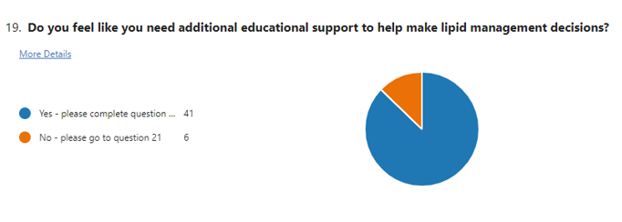
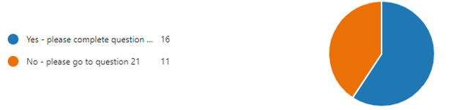
Learning Need Analysis (LNA)
Structured 24 questions help identify current competency and confidence in lipid lowering therapies.
Received 46 replies at the start of project and 27 responses at the end (from participating PCNs)
At the start: 87% felt they need additional educational support; this was reduced to 59% at the end.
In general, we observed positive shifts in confidence and knowledge for the use of LLTs, especially statins, ezetimibe, bempedoic acid, and inclisiran; improved understanding of lipid profiles and targets, interpreting secondary causes, when to initiate LLTs in CVD, understanding of FH and an increased awareness of how to navigate the standardised national lipid pathway.
Baseline Result
Post Project Result

Slide 10
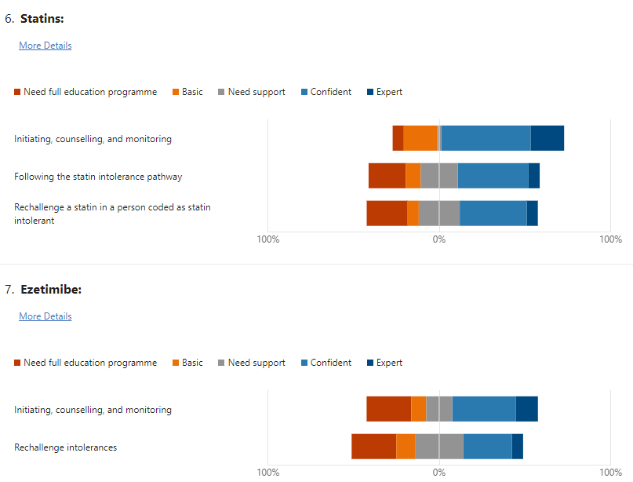
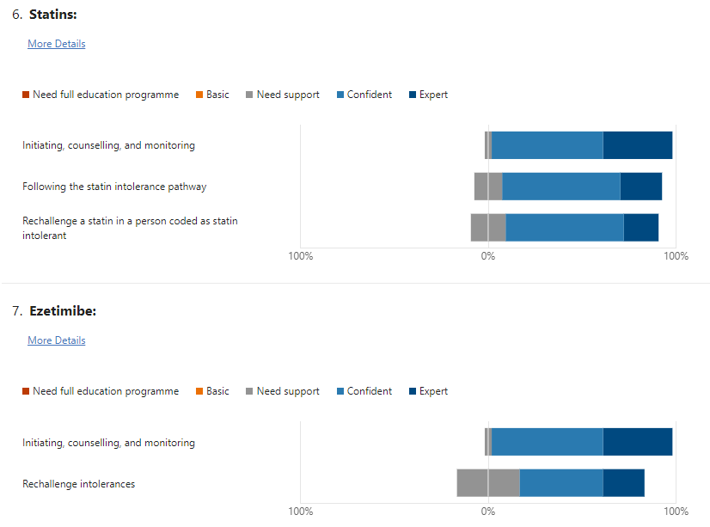
Summary of lipid-lowering therapies
Baseline data (47 responses)
Post project data (27 responses)
Notes:
Statins and ezetimibe

Slide 11
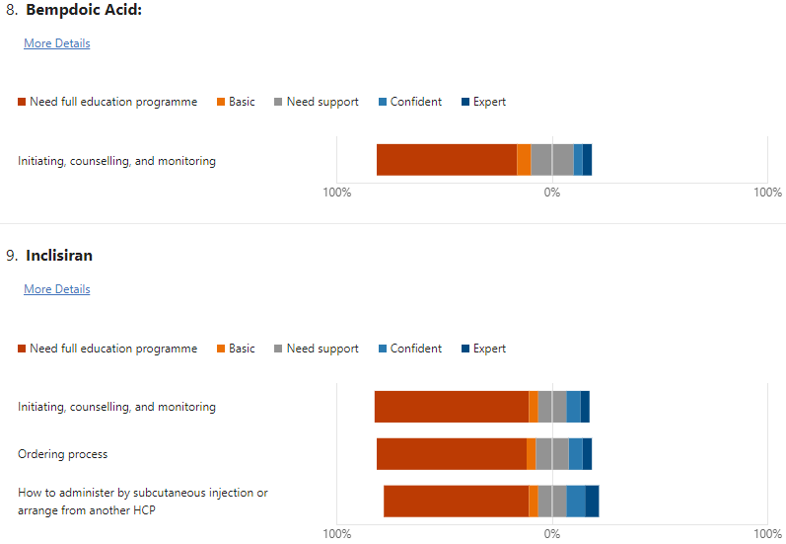
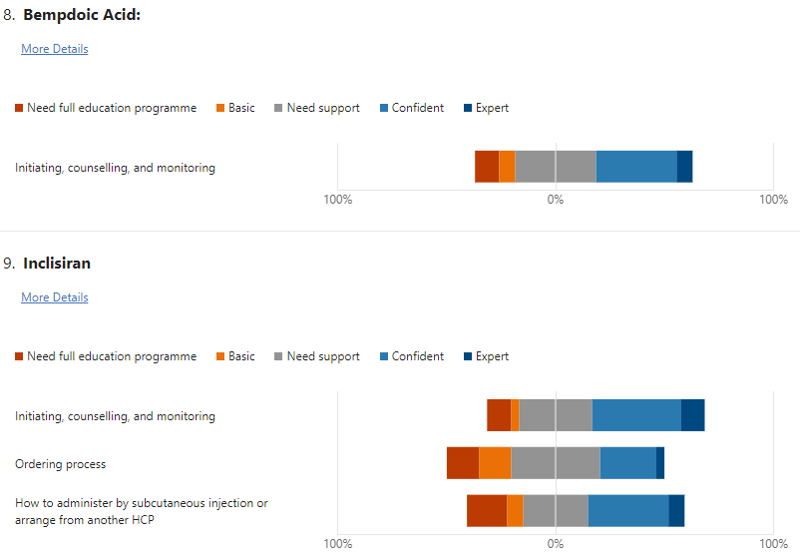
Summary of lipid-lowering therapies
Baseline data (47 responses)
Post project data (27 responses)
Notes:
Newer LLTs Bempa and inclisiran

Slide 12
Highlights from PCN
Five Parks
able to work with other MDT and GP Specialised in CVD
PA help with reviews and organise for bloods
patient more receptive to statins, due more knowledgeable and more confidence.
dedicated time on Wednesday to work on lipid management
better awareness with GP/nurses, share resources, getting more referrals from other MDTS, GP/Nurse
better uptake by patients, have more time consultations with patients.
Pharmacist CVD lead clinics in Beeston PCN - tech does bloods and pharmacist optimises lipids/oral meds and administers inclisiran
Discussions with practice team (GPs, nurses together) to discuss national lipid pathway and understanding of bloods (examples shown to practices of bloods filed as normal but are above target).
Seacroft PCN - whole team upskilled in lipid management, time protected to work on lipid optimisation. Inclisiran protocol, more patients inclisiran
Inclisiran protocol, more patients inclisiran
Five Parks PCN - now initiation with ezetimibe, more collaborative working across PCNs
Notes:
PCN check-in meeting

Slide 13
PCN Impact Survey (13 out of 16 PCNs responded)
85% (n=11) strongly agreed/agreed that their PCN and practice workforce were upskilled to utilise the full lipid pathway. The remaining PCNs reported slight progress was made.
100% (n=13) strongly agreed/agreed that their PCN and practice workforce were more confident managing statin intolerance.
100% (n=13) strongly agreed/agreed that their PCN started routinely and proactively optimising patient lipids. 5 PCNs had set up a lipid clinic.
31% (n=4) strongly agreed/agreed that their PCN routinely initiates inclisiran.
46% (n=6) strongly agreed/agreed that their PCN had created extra phlebotomy capacity to manage increased lipid blood tests.
77% (n=10) strongly agreed/agreed that their PCN proactively signpost patients to community pharmacy for New Medicines Service
92% (n=12) would like to see A&G support to continue from secondary care for lipid optimisation. The 1 PCN that did not agree explained that they would like to see our integrated MDT and A&G approach continue, but not the traditional A&G referral to cardiology that would take a long time.

Slide 14
So, we achieved our main goal to upskill primary care clinicians…
Did we achieve lipid management outcome in patients with CVD from our participating PCNs?

Slide 15
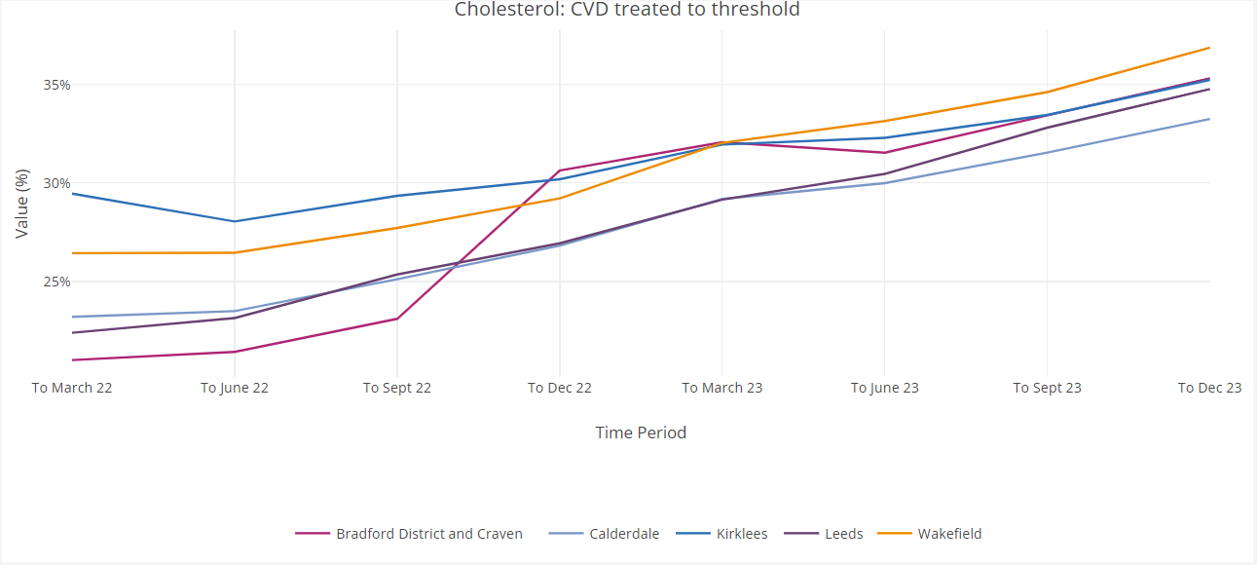
CVDPrevent: CVD Treated to Lipid Threshold
According to CVDPrevent CVDP007CHOL indicator, for West Yorkshire, the percentage of patients with cardiovascular disease (CVD) treated to lipid target increased from 25.9% in Sep’22 to 35.2% in December’23 (9.3% improvement).
In most deprived areas for each sub-ICB, there were increase in performance for this CVDPrevent metric in the same period.
Leeds: 7.97% improvement
Bradford: 9.24% improvement
Wakefield: 9.45% improvement
Calderdale: 9.15% improvement
Kirklees: 5.53% improvement
This project working across WY had successfully narrowed the gap between different sub-ICBs.
The health inequality gap on CVDPrevent between the most and least deprived areas was reduced by 0.23%. We had a target to reduce it by 2%, so more work still needed to be done to overcome further barriers.
Notes:
Table Mar23 = Sep'22 CVDP
Table Jun23 = Dec'22 CVDP
Table Sep23 = Mar'23 CVDP
Table Dec23 = Jun23 CVDP

Slide 16
Data Collected from GP Systems
Measures for patients with CVD in Targeted PCNs | March’23 (%) | December’23 (%) | May’24 (%)
% with non-optimised lipids | 60 | 59 | 59
Proportion with no LLT | 14 | 12 | 10
Inclisiran uptake per patient | 0.02 | 0.3 | 0.49
Bempedoic acid & ezetimibe uptake per patient | 0.02 | 0.26 | 0.41
The project has improved levels of prescribing for each step of the national lipid pathway, including uptake of NICE-approved new drugs like inclisiran and bempedoic in participating PCNs.
In comparison to the average change across the ICB, the participating PCNs increased the number of patients optimised by 1 percentage point more than the ICB’s average in December 2023 accounting for 333 additional patients optimised.
Assuming all 333 patients lowered their LDL-C by 1mmol/L, it could potentially prevent 33 major vascular events and potentially save £495,000 of CVD events cost over 10 years (cost of each CVD event £13,000 to £15,000).
Notes:
Dec'23 - 8% reduction overall

Slide 17
Number of Patients with Non-Optimised Lipids from Participating PCNs
Time period | Mar-23 |  | Jun-23 |  | Sep-23 |  | Dec-23 |  | May-24
PCN | Patient count | % of CVD register | Patient count | % of CVD register | Patient count | % of CVD register | Patient count | % of CVD register | Patient count | % of CVD register | % Change in number of patients with non-optimised lipids
WHOLE ICB (Total) | 74540 | 60% | 74378 | 61% | 70152 | 59% | 69532 | 60% | 66439 | 59% | -11
IN SCOPE PCNs (Total) | 21310 | 60% | 21213 | 61% | 19887 | 59% | 19663 | 59% | 17798 | 59% | -16
BD4+ | 1081 | 56% | 1048 | 56% | 1033 | 56% | 1006 | 56% | 962 | 56% | -11
Beeston | 767 | 53% | 818 | 58% | 789 | 57% | 771 | 57% | 709 | 55% | -8
Bradford North West | 916 | 47% | 903 | 47% | 875 | 47% | 876 | 48% | 859 | 49% | -6
BWM | 668 | 57% | 692 | 60% | 676 | 60% | 676 | 62% | 624 | 59% | -7
BHR | 1082 | 55% | 1142 | 59% | 1114 | 59% | 1075 | 59% | 1038 | 59% | -4
Central Halifax | 1825 | 69% | 1755 | 68% | 1693 | 67% | 1562 | 64% | 1468 | 62% | -20
Dewsbury & Thornhill | 1218 | 68% | 1190 | 68% | 1083 | 62% | 1113 | 65% | 1054 | 64% | -13
Five Lane Ends | 762 | 47% | 755 | 47% | 729 | 47% | 721 | 48% | 693 | 48% | -9
Middleton & Hunslet | 725 | 53% | 766 | 57% | 736 | 56% | 707 | 55% | 680 | 54% | -6
North Halifax | 1837 | 74% | 1809 | 73% | 1760 | 73% | 1713 | 72% | 1554 | 69% | -15
Bradford City 4 | 806 | 50% | 790 | 50% | 750 | 48% | 754 | 50% | 690 | 47% | -14
Five Parks | 1581 | 58% | 1535 | 58% | 1482 | 58% | 1519 | 58% | 1435 | 57% | -9
Seacroft | 887 | 55% | 923 | 58% | 905 | 58% | 856 | 57% | 795 | 55% | -10
Viaduct Care | 1897 | 71% | 1850 | 71% | 1196 | 47% | 1427 | 58% | 1612 | 68% | -15
Wakefield Health Alliance North | 1750 | 70% | 1721 | 70% | 1667 | 69% | 1573 | 66% | 1416 | 62% | -19
Wakefield Health Alliance South | 2550 | 63% | 2487 | 63% | 2395 | 61% | 2338 | 61% | 2209 | 60% | -13
Notes:
Biggest reduction in number: Central Halifax, Wakefield North, North Halifax and Viaduct Care.

Slide 18
% of CVD Patients Not On Any LLTs
All targeted PCNs had reduction in %

Slide 19
Barriers
Time and capacity – perceived lack of funding
Lack of data sharing agreement across WY
Use of referral template
Negative views on inclisiran

Slide 20
STF Project: Lessons Learnt
What worked well:
Collaboration across West Yorkshire ICB places and teams
Ownership of provider organisation (LTHT) to deliver this project
Formation of WY Lipid Optimisation Clinical Taskforce (LOCT) Network
Good complex cases being referred to LTHT lipid MDT
Positive value to the system: upskilling primary care and improving CVD lipid treated to target value
What could be done differently:
Start DPIA as early as possible in the project
Resistance with referral of cases to MDT due to patient case proforma template so next time DQ can merge it to letter template on clinical system
Format of virtual MDT can be more frequent and be the main feedback mechanism
Challenge to directly influence increasing NMS referral to community pharmacies
Plan in project management support before starting project
Unclear governance structure in WYICB for this project and LOCT Network, need clearer roles and responsibilities between places and central team.
Notes:
It's a genuine collaboration of teams coming together to work on this project. Meds Opt Steering Group is where we report to; but we also work closely with the WY LTC and Personalised Board (CVD Programme) to feed into their outcomes.

Slide 21
Any Questions?
Thank you

